Slide 1
AGFJ100
REGISTRATION PLATFORM EDITS

Slide 2


Slide 3
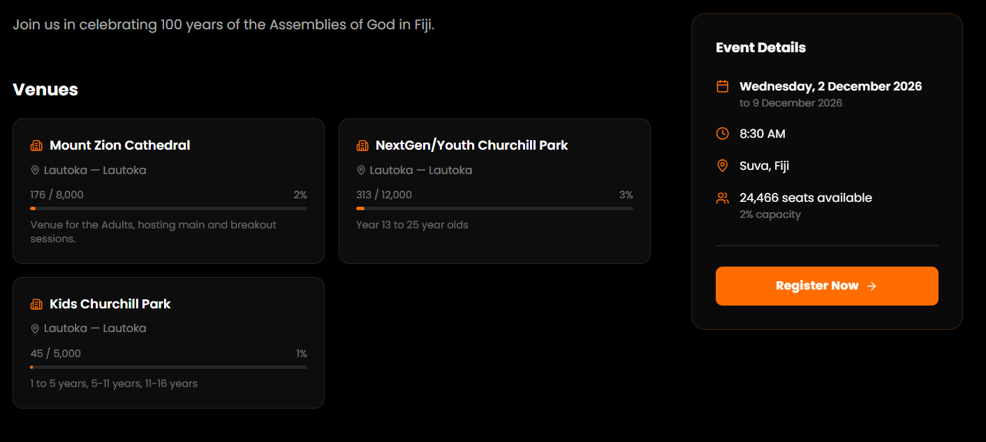

Slide 4
Recommend event details grid – to be included in previous slide to replace current event details
Date | Venue | Program | Time | Evening Rally : Churchill Park, Lautoka
Mon, 7 Dec | Mount Zion Cathedral, Saru | Adults | 9am – 1pm | From 6pm
Tues, 8 Dec to Fri, 11 Dec | Mount Zion Cathedral, Saru | Adults | 9am – 1pm | From 6pm
 | Churchill Park, Lautoka | Next Gen/Youths Next Gen Kids | 9am – 1pm | From 6pm
Sat, 12 Dec | Churchill Park, Lautoka | Next Gen/Youths | 9am – 1pm | No Service
 | Sheraton Fiji Golf & Beach Resort, Denarau | Centennial Dinner Celebrations | 5.30pm – 10.00pm | Email : agfijievents@gmail.com
Sun, 13 Dec | Churchill Park, Lautoka |  |  | From 6pm

Slide 5
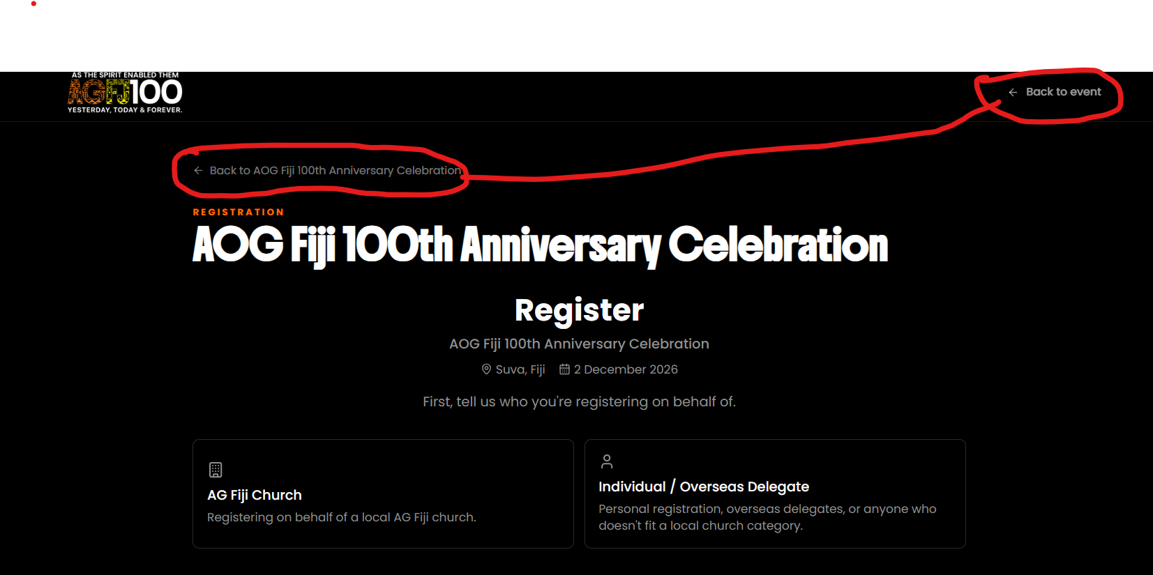

Slide 6

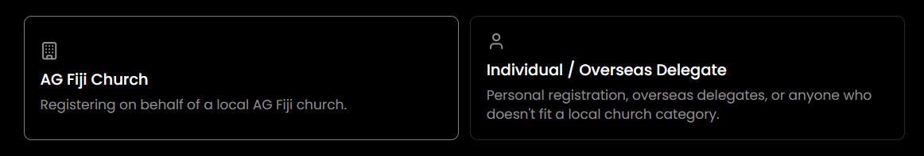
Updated sample copy + treatment of opening registration page
R E G I S T R A T I O N
ASSEMBLIES OF GOD, FIJI
100TH ANNIVERSARY CELEBRATION
W E L C O M E
A week-long celebration of God’s faithfulness over the century and what he will be continue to do in the
AOG Fellowship in Fiji.
(Pin Icon) : Lautoka (Calendar icon) : 7 – 13 December, 2026
Note:
This platform registers participation for daily sessions
Choose any category below.
For assistance, if none of the categories apply for you, please email 100@agfiji.org for assistance

Slide 7
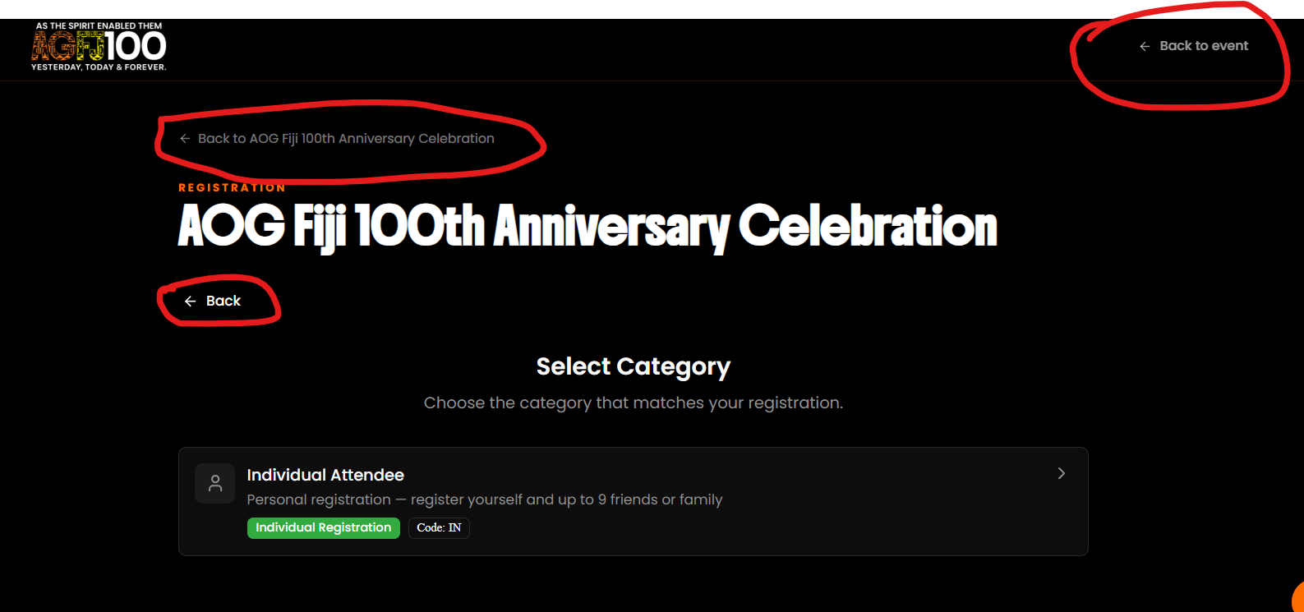

Slide 8
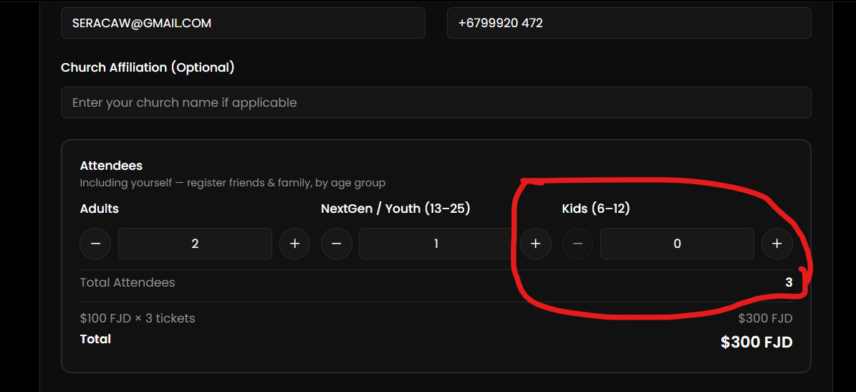

Slide 9
AOGFIJI EVENT PAGE

Slide 10
